Slide 1
Bullying
Lets Take a Stand!

Slide 2

2 in 3 kids are bullied each year

Slide 3
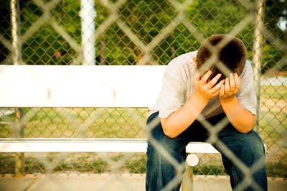
Why would you want to be the kid who made him feel like that

Slide 4

You made them not want to go to school

Slide 5

What if you were in there shoes how would you feel

Slide 6

That person that you made feel like that is Awesome

Slide 7

So stop its not funny or cool

Slide 8

Stand up not be the one stood up to

Slide 9
Lets stop bullying together

